Slide 1

CS50 students
Another new programming language

Slide 2
cs50.ly/section_attendance

Slide 3
cs50 section 7
SQL
Andrew Holmes 2023

Slide 4
Today’s plan
SELECT
03
Complex queries
01
02
CREATE/INSERT
04
PSET
Get data
Nested queries, JOINs
Modifying data
Doing the thing ☺

Slide 5
01
SELECT
Getting data

Slide 6
Database structure
SELECT
Database file
Table: pokemon
Table: trainers
id | name | type
1 | Pikachu | Electric
2 | Oshawott | Water
3 | Pidgey | Normal
id | name
1 | Andrew
2 | Carter
column

Slide 7
Dataset
Table: pokemon
SELECT
id | name | type_1 | type_2 | level
1 | Pikachu | Electric | None | 24
2 | Charizard | Fire | Flying | 98
3 | Oshawott | Water | None | 100
4 | Mew | Psychic | None | 80
5 | Mudkip | Water | None | 8
6 | Cyndaquil | Fire | None | 12
7 | Pidgey | Flying | Normal | 6

Slide 8
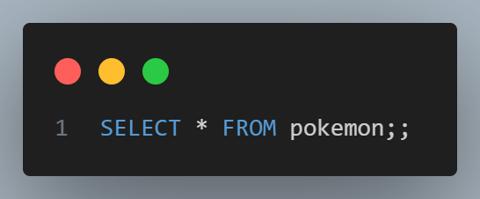
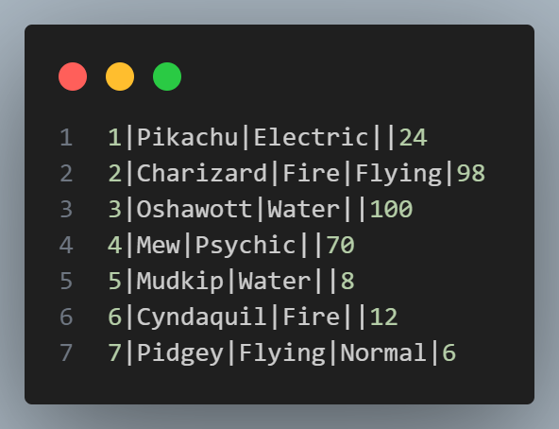
SELECT
SELECT
SELECT keyword for getting information!
FROM keyword to decide which table to look for data in

Slide 9
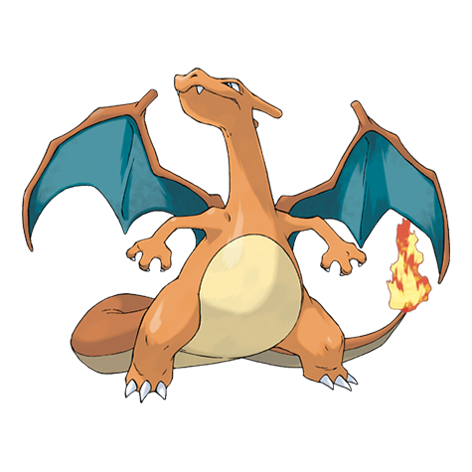
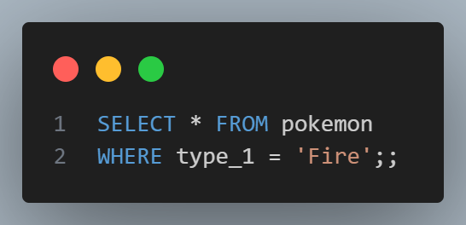

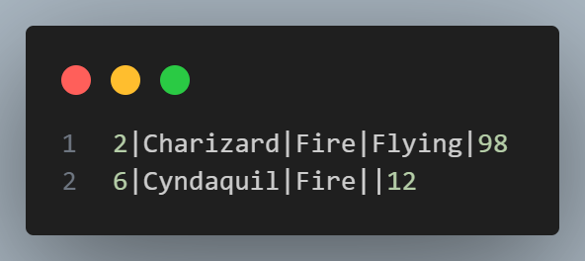
WHERE
SELECT
WHERE keyword for applying restrictions!

Slide 10
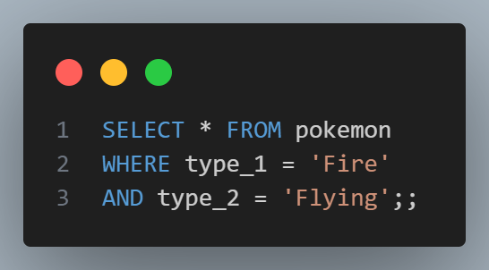
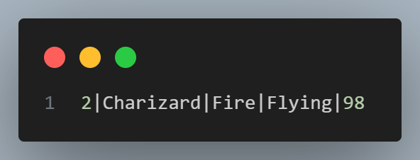
AND
SELECT
AND keyword for applying multiple restrictions!

Slide 11
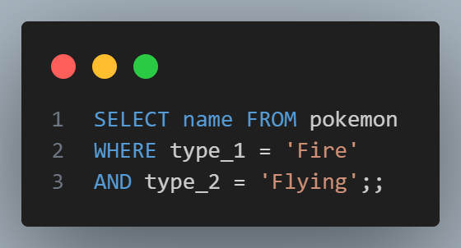
SELECTING individual columns
SELECT

Slide 12
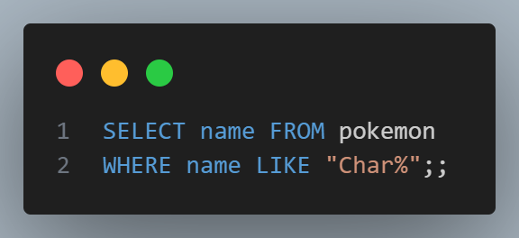
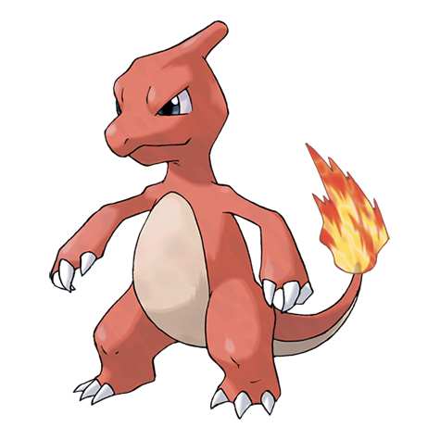

Using LIKE and %
SELECT

Slide 13

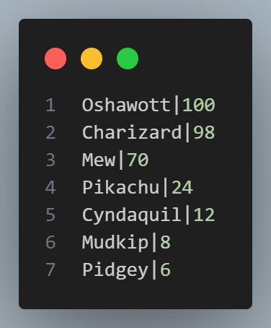
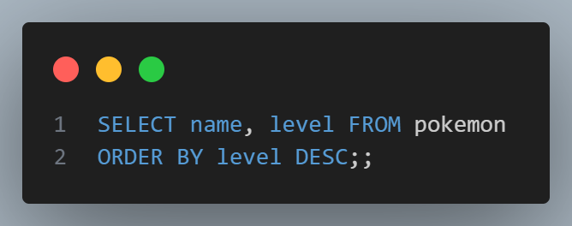
Ordering
SELECT
multiple columns
ORDER BY … DESC

Slide 14
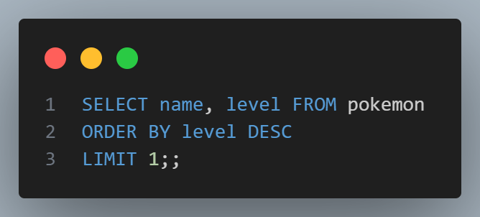
LIMIT
SELECT
When only the finest will do…

Slide 15
03
Complex queries
Nested SELECTs, JOINs

Slide 16
Dataset
Table: pokemon
Queries
id | name | type_1 | type_2 | level
1 | Pikachu | Electric | None | 24
2 | Charizard | Fire | Flying | 98
3 | Oshawott | Water | None | 100
4 | Mew | Psychic | None | 80
5 | Mudkip | Water | None | 8
6 | Cyndaquil | Fire | None | 12
7 | Pidgey | Flying | Normal | 6

Slide 17
Dataset
Table: partnerships
Queries
poke_id | trainer_id
1 | 3
2 | 2
3 | 2
4 | 3
5 | 4
6 | 3
7 | 1
Table: trainers
id | name
1 | Carter
2 | Andrew
3 | Mark
4 | Phyllis

Slide 18
Trainers
Queries

Slide 19
Association tables
Queries
Trainers
id
name
partnerships
trainer_id
pokemon_id
pokemon
id
Name
type_1
type_2
level
Known as an ‘association table’ or ‘junction table’
Q: When are association tables a good idea? Is this one good?

Slide 20
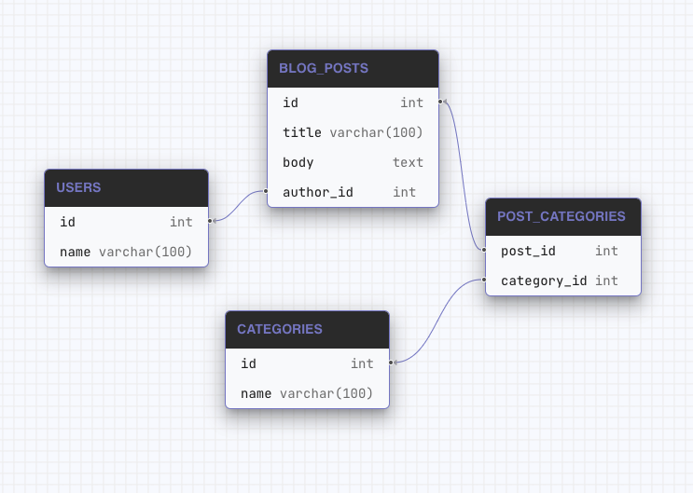
Association tables
Queries
Q: Is this a good usage of association tables?
A: Yes – post can be in many categories, and category can contain many posts. Many-to-many.
Notes:
Source: Applying Schemas | Atlas | Open-source database schema management tool (atlasgo.io)

Slide 21
JOIN vs nested queries
Queries
JOINs are expensive! But sometimes necessary:
You want to retrieve data columns from more than one table,
e.g. trainer name and pokemon name in one query.

Slide 22
04
PSET
Week ahead

